Slide 1
Describe Features of Linux Operating system in management of server.

Slide 2
learning outcomes
By the end of this lecture, you are expected to be familier with the concept relating to linux operating system in server management.
key terms:
LINUX, OS, SERVER and MANAGEMENT
Components of linux OS:
Basic features of Linux OS
The Linux OS architecture
Linux OS Distributions

Slide 3
Definition of Terms
OS: Is system software that manages computer hardware, software resources, and provides common services for Computer, Mobile phone and tablet computer programs. “ Its a bridge”
To name types or different flavours of the Operating system depends on the device being considered.
Computer Based OS:
Windows OS
MAC OS
Linux Os
Mobile Based OS
Apple iOS
Google Android
HarmonyOS

Slide 4
Definition of Terms
LINUX: Is a Unix-like, open source and community-developed operating system (OS) for computers, servers, mainframes, mobile devices and embedded devices.
SERVER: A computer or system that provides resources, data, services, or programs to other computers, known as clients, over a network.
MANAGEMENT: Is the administration of an organization, whether it is a business, a non-profit organization, or a government body.
SERVER MANAGEMENT: is the process of monitoring and maintaining servers to operate at peak performance

Slide 5
Components of linux OS
Linux Operating System has primarily three components:
Kenel: Is the core part of Linux. It is responsible for all major activities of this operating system. Kernel provides the required abstraction to hide low level hardware details to system or application programs.
System libraries: Are special functions or programs using which application programs or system utilities accesses Kernel's features.
System Utility: Programs are responsible for doing specialized, individual level tasks.
Other Scholars describe the linux components as being 4. Adding Hardware to the above list.

Slide 6
Basic features of Linux OS
Portable Environment : Linux software operates flawlessly on a variety of hardware platforms.
Free and Open-Source : Its source code is available for anybody to use and alter.
Shell/ Command-line Interface: The Linux system includes essential programs that users can utilize in order to issue commands to the operating system for executing the design flawlessly.
End-to-end encryption: Authentication can help you keep your data protected. Before you may access some critical files, the Linux Operating System requires you to enter a password.

Slide 7
Basic features of Linux OS ....
Graphical User Interface (GUI): Linux Operating System comes with Graphical User Interface (GUI) abilities in the same way you can with Windows. Configure Keyboards into Different Languages
LUI /CLI: Line user interface /Command line user interface is the interaction portal between the user and the OS.
Frequent New Updates: Software updates are controlled by the users in Linux.
Lightweight Infrastructure: Linux is a highly lightweight operating system. Linux has far fewer prerequisites than any other operating system, has a smaller memory footprint, and uses less storage spaceExtremely Flexible
Best For Developers: Linux supports nearly every popular programming language, including C/C++, Java, Python, Ruby, etc. Furthermore, it provides a wide range of development-related applications.

Slide 8
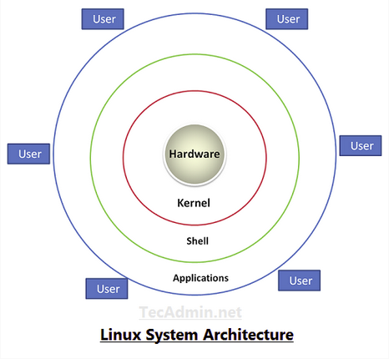
The Linux OS architecture

Slide 9
The Linux OS architecture
Hardware − Hardware consists of all physical devices attached to the System. For example: Hard disk drive, RAM, Motherboard, CPU etc.
Kernel − Kernel is the core component for any (Linux) operating system which directly interacts with the hardware.
Shell − Shell is the interface which takes input from Users and sends instructions to the Kernel, Also takes the output from Kernel and send the result back to output shell.
Applications − These are the utility programs which runs on Shell. This can be any application like Your web browser, media player, text editor etc.

Slide 10
Linux OS Distributions
Linux distribution: Is an operating system that is made up of a collection of software based on Linux kernel.
or
We can say a distribution (Distro) ia an OS that contains the Linux kernel and supporting libraries and software.
Linux Distros:
Ubuntu:
Fedora
Linux Mint
OpenSUSE
Debian
CentOS

Slide 11
Related readings:
https://www.linux.org
https://www.unixmen.com/list-top-linux-distributions/
https://distrowatch.com/dwres.php?resource=major
https://www.javatpoint.com/architecture-of-linux
https://www.tutorialspoint.com/operating_system/os_linux.htm
https://www.techtarget.com/searchdatacenter/definition/Linux-operating-system

